Slide 1
Xamarin.Forms
Mykhail Galushko
Co-founder DevRain Solutions & Avantime Ukraine

Slide 2
Agenda
What is Xamarin.Forms
Xamarin.Forms features and tools
Xamarin.Forms: why?
Xamarin.Forms 3.0
Demo
Performance tips, tools and libraries to use
Q&A

Slide 3
What is Xamarin.Forms
Native UI for each platform
Platforms: iOS, Android, UWP, WinRT, WP8.1, WPF (coming), MacOS (preview)

Slide 4
Xamarin + Xamarin.Forms
iOS C# UI
Android C# UI
Windows C# UI
Shared UI Code
Shared C# Backend
Shared C# Backend
Traditional Xamarin Approach
With Xamarin.Forms: More code-sharing, all native

Slide 5
Xamarin.Forms app structure
Android
UWP
iOS
Platform specific code
Shared code
Portable UI based on Xamarin.Forms
Portable View Models
Portable Models & Code Services

Slide 6
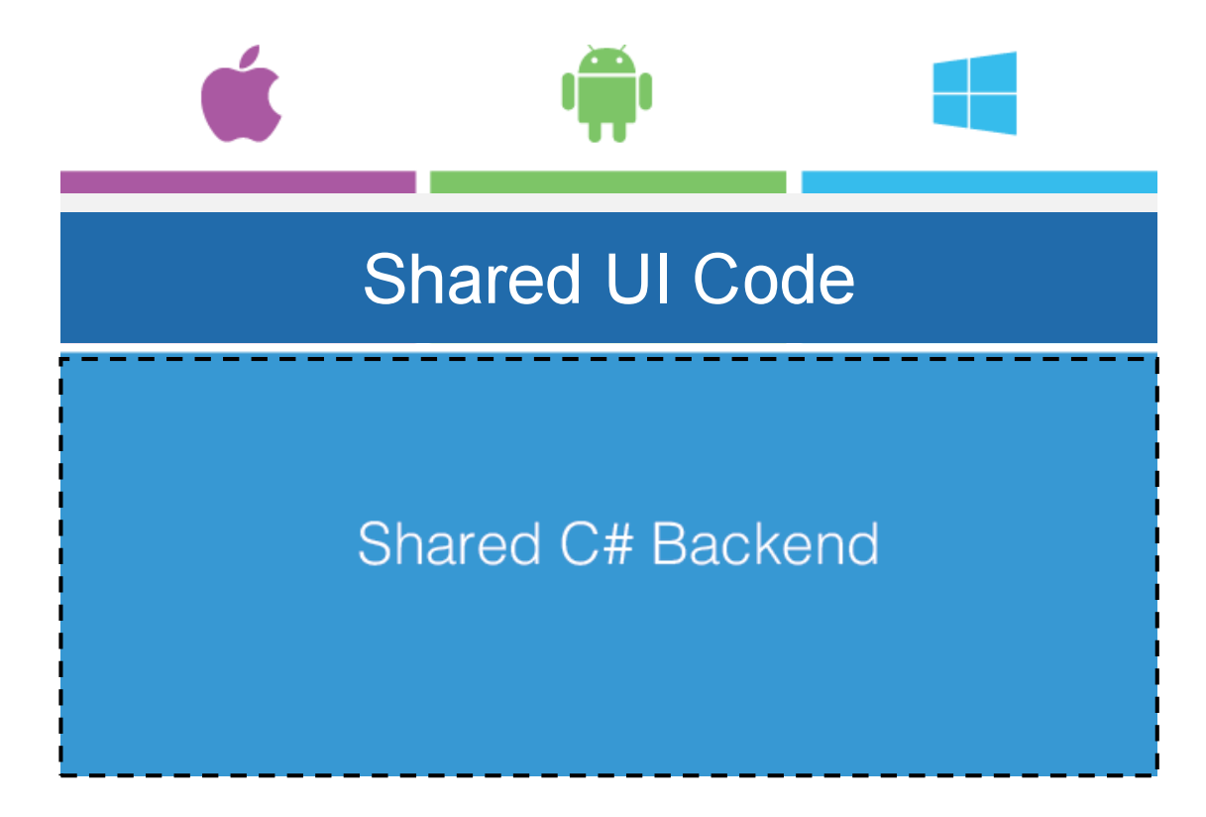
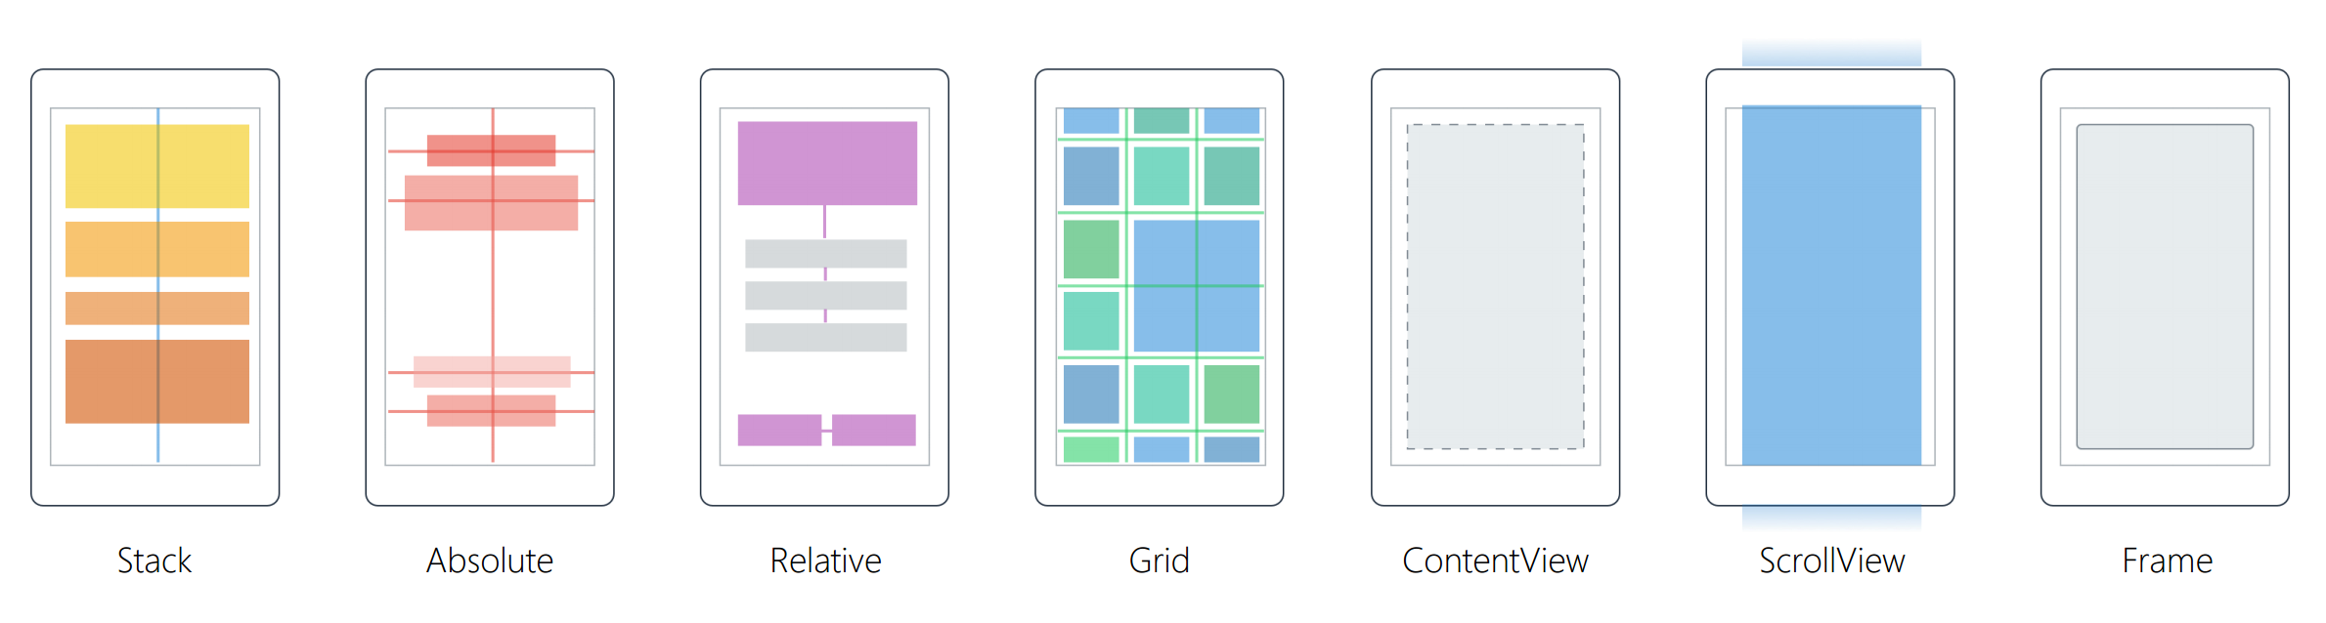
What’s included
40+ Pages, Layouts, and Controls
Build from code behind or XAML
Two-way Data Binding
Navigation
Animation API
Dependency Service
Messaging Center

Slide 7
Controls
ActivityIndicator
BoxView
Button
DatePicker
Editor
Entry
Image
Label
ListView
Map
OpenGLView
Picker
ProgressBar
SearchBar
Slider
Stepper
TableView
TimePicker
WebView
EntryCell
ImageCell
SwitchCell
TextCell
ViewCell

Slide 8
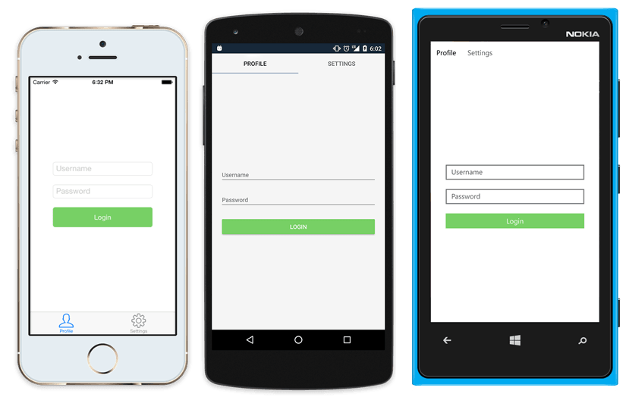
Native UI from shared code
<?xml version="1.0" encoding="UTF-8"?>
<TabbedPage xmlns="http://xamarin.com/schemas/2014/forms"
xmlns:x="http://schemas.microsoft.com/winfx/2009/xaml"
x:Class="MyApp.MainPage">
<TabbedPage.Children>
<ContentPage Title="Profile" Icon="Profile.png">
<StackLayout Spacing="20" Padding="20"
VerticalOptions="Center">
<Entry Placeholder="Username"
Text="{Binding Username}"/>
<Entry Placeholder="Password"
Text="{Binding Password}"
IsPassword="true"/>
<Button Text="Login" TextColor="White"
BackgroundColor="#77D065"
Command="{Binding LoginCommand}"/>
</StackLayout>
</ContentPage>
<ContentPage Title="Settings" Icon="Settings.png">
<!-- Settings -->
</ContentPage>
</TabbedPage.Children>
</TabbedPage>

Slide 9
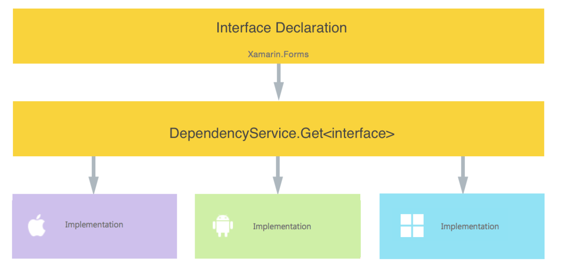
Dependency Service

Slide 10
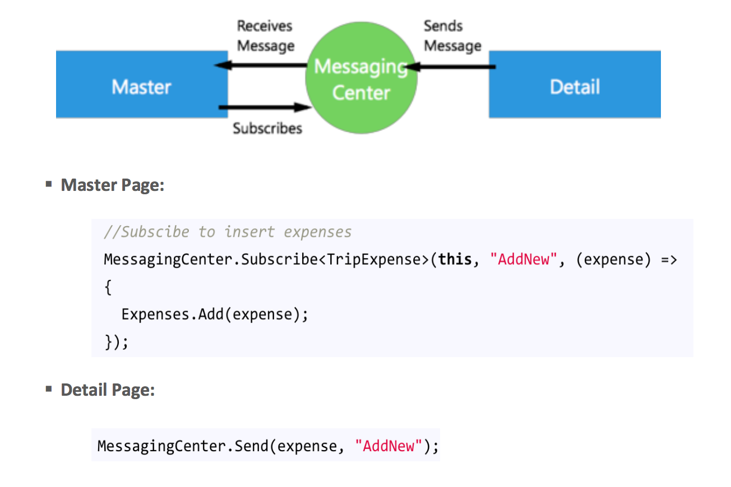
Messaging Center

Slide 11
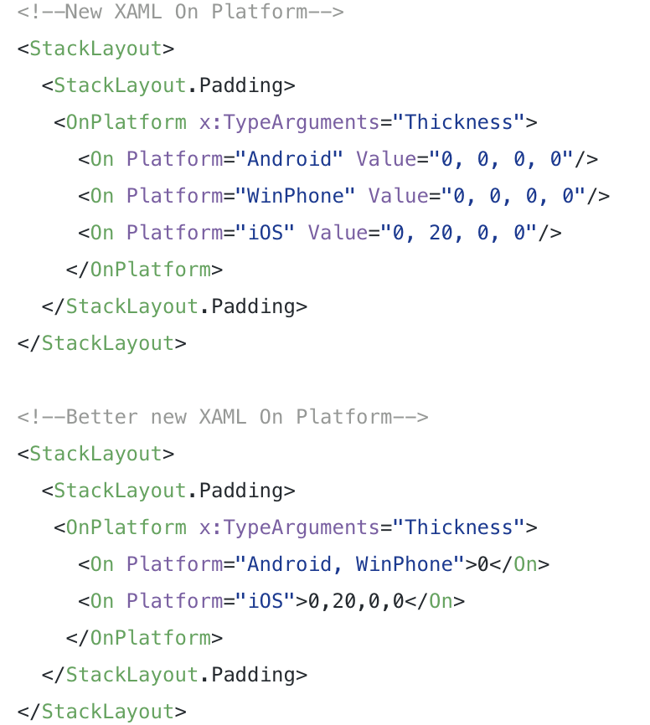
Platform
Customization

Slide 12
Effects I
✓ Custom renderer “lite”
✓ Change properties on the native control
✓ Optional
✓ “stringly-typed”
X No methods or events
X No replacing the control

Slide 13
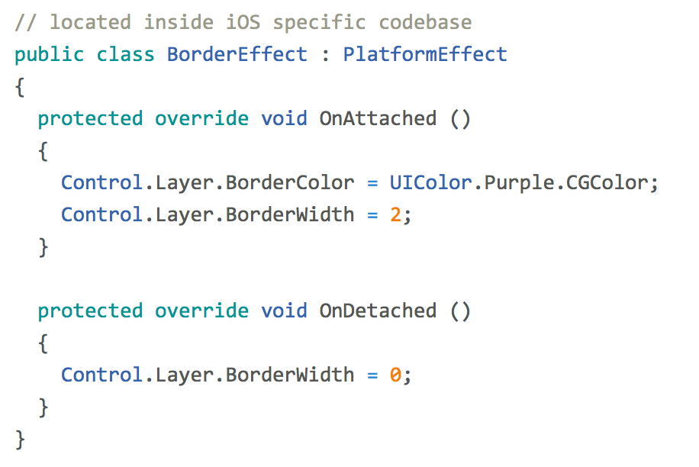
Effects II
entry.Effects.Add (Effect.Resolve("Xamarin.BorderEffect"));

Slide 14
Custom Renderers
Extend Forms functionality
Override methods of platform specific control
Replace platform specific control that implements Xamarin.Forms control

Slide 15
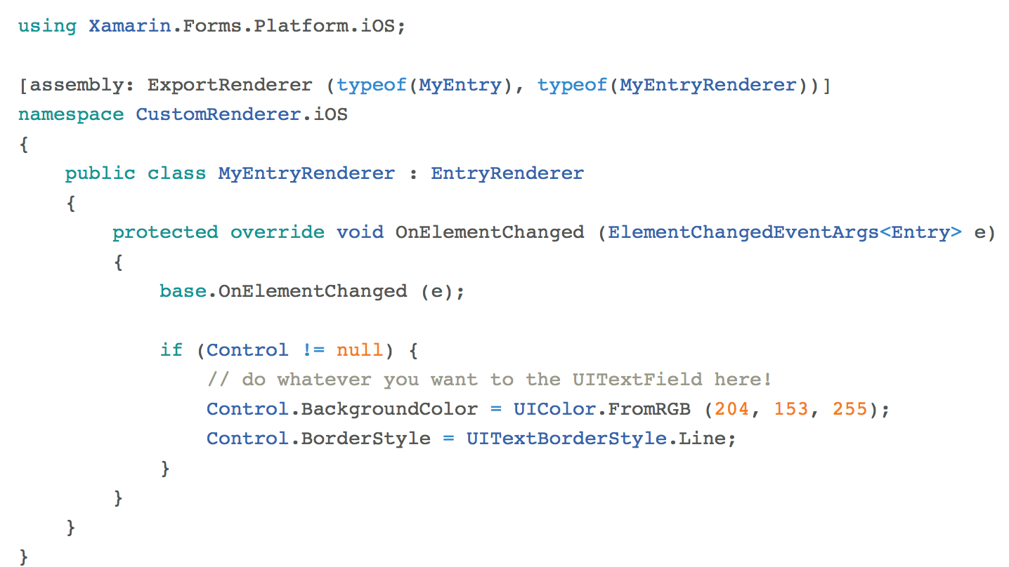
Custom Renderers

Slide 16
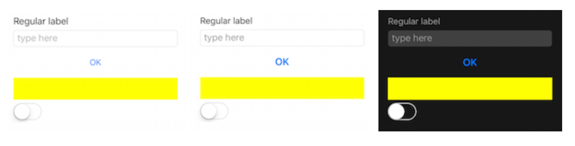
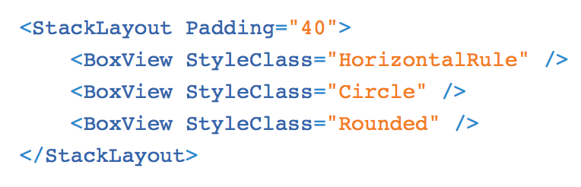
Themes

Slide 17
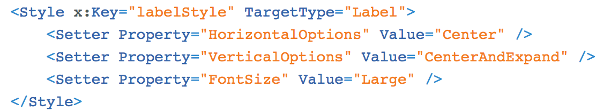
Styles

Slide 18
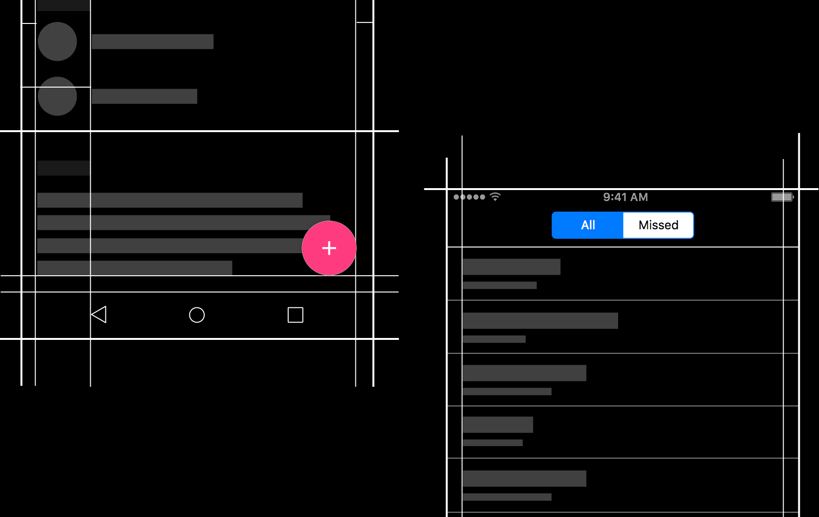
Native Embedding

Slide 19
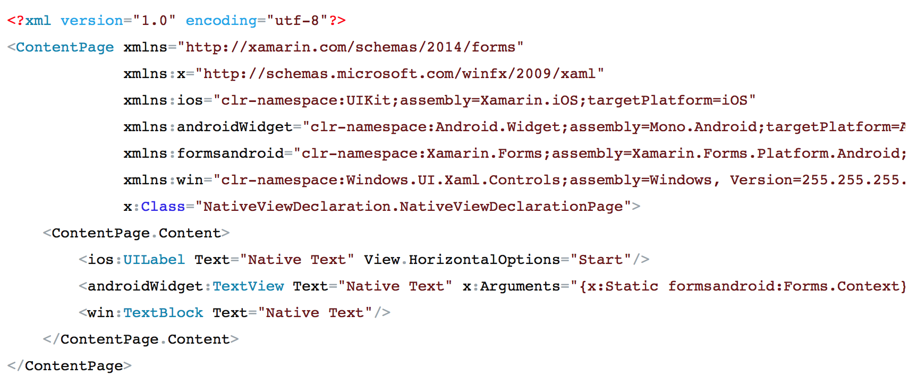
Native Embedding XAML + Code behind

Slide 20
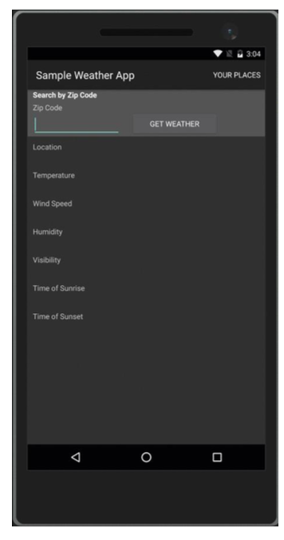
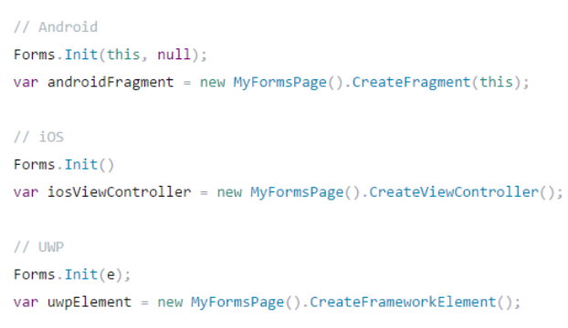
Xamarin.Forms Embedding (beta now)
Embed any page into Xamarin Native application

Slide 21
XAML Previewer

Slide 22
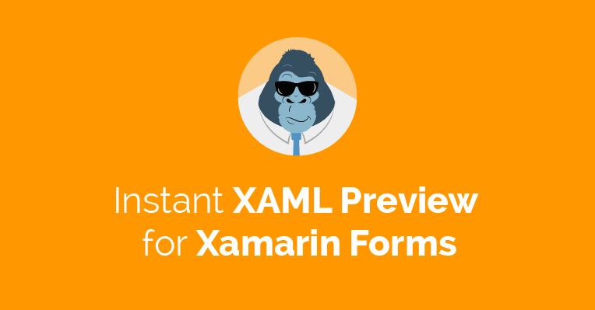
Gorilla Player
Instant UI preview
VS integration (Windows + Mac)
Design Time data
Prism support
ContentViews support
XAML warnings and errors notifications
http://gorillaplayer.com

Slide 23
XAML Compilation
XAML
XAMLC
Faster loading, slower compilation
Smaller app size
XAML errors at build time
Better disable during development
Compile-time
Parsed & turned into IL
Runtime
Parsed and inflated

Slide 24


Xamarin.Forms Ecosystem

Slide 25
Why you should use Xamarin.Forms
Fast POC
Minimize costs for development for multiple platforms:
common interactions across device platforms
code sharing is more important than custom UI
little platform-specific features
You are focusing on LOB apps
You are not writing games
You would like to partially reuse code from WPF/UWP

Slide 26
Xamarin.Forms: Pros
Shared code for UI and Business layers
Easy start for .NET developers
C# / Visual Studio / Resharper
MVVM
Native embedding & XF embedding
Custom renderers
Styles
Not Javascript
Open Source + Plugins
Rider
Xamarin Test Cloud
Xamarin Live Player
Gorilla Player
Binding allows to reuse any existing native library

Slide 27
Xamarin.Forms: Cons
Performance issues
Still bugs – be careful of updates: platform and tools
Build and deploy time (mostly for Android)
Custom renderers
Application package size
Backward compatibility issues
Lack of controls
Xamarin Studio / Visual Studio for Mac
Debugging issues
Memory issues

Slide 28
DEMO

Slide 29
Performance tips
FFImageLoading for managing images
ModernHttpClient for HTTP
ListView caching strategy: RetainElement, RecycleElement (use this)
Be careful of events: memory leaks
Use StackLayout instead of Grid if possible
Use Grid instead of multiple StackLayouts if possible
Prefer using LayoutOptions.Fill (FillAndExpand)
Prefer star-sized grid columns/rows rather than auto-sized
Try to avoid RelativeLayout
Pack views in constructor rathen than in OnAppearing
Do not use StackLayout inside ScrollView to simulate ListView

Slide 30
Performance tips
Do not use ListView inside ScrollView: use ListView.Header and Footer
Use ListView rather than TableView
Do not use nested ListViews
Use HasUnevenRows for different rows size in ListView. Or call ForceUpdateSize to have dynamic sizing
Await PushAsync and PopAsync
Use AppCompat backend for Android
Do not use CarouselPage, use CarouselView with ContentPage
Messaging Center: prefer to use smth else

Slide 31
What to use
Prism/{your choice} as MVVM framework
Akavache for caching and storing data on device
Polly for smart HTTP requests logic
SQLite.NET for SQLite database
PCLStorage for files
PCLCrypto for cryptography
NGraphics to render vector graphics + NControl for custom controls
Realm – mobile database
ACR.* for many things: user dialogs, device integration etc

Slide 32

Grial UI.Kit
70+ editable screens
Rich animations (Lottie)
1500+ icons
Fully themeable
Optimized for tablets and phones
http://grialkit.com

Slide 33
Xamarin.Forms 3.0 is coming
Xamarin.Forms embedding
Platforms: MacOS, Linux, WPF, Tizen
Performance improvements: fast renderers, layout compression, FlexLayout, VisualStateManager, CSS-style Styling
XAML Standard support

Slide 34

“Resharper” for Xamarin Studio / Visual Studio for Mac
Code actions
Organise, refactor and generate code
Code analysis
Inspects source code for bugs, errors and improvements
Navigation
Enables you to easily move around your source code
mfractor.com

Slide 35

Rider – cross-platform IDE based on IntelliJ platform and Reshaper (Jetbrains)
Support for most .NET project types
Resharper features included

Slide 36
Q&A
mykhail.galushko@devrain.com

